Slide 1
Cyclistic Case Study
Brad Merchant
bradmerchant@gmail.com

Slide 2
Executive Summary
Company
Offerings
Strategy
Cyclistic is a bike-share company operating in Chicago with over 5,800 bikes and 600 docking stations.
Cyclistic offers flexibility with annual memberships and single-ride passes for traditional and electric bikes.
Annual subscribers are the key to Cyclistic’s growth and long-term success.

Slide 3
Questions & Challenges
Challenge 1
Challenge 2
Challenge 3
Understand Customer Habits
How do annual members and casual riders use Cyclistic bikes differently?
Create Value
Why would casual riders buy Cyclistic annual memberships?
Conversion to Annual Members
How can Cyclistic use digital media to influence casual riders to become members?

Slide 4
At a Glance
July 2022 - June 2023
Total Number of Trips
5.7 M
Average Ride Duration
18 min
Busiest Day
Saturday
Busiest Time
5pm-6pm
Busiest Months
June - August

Slide 5
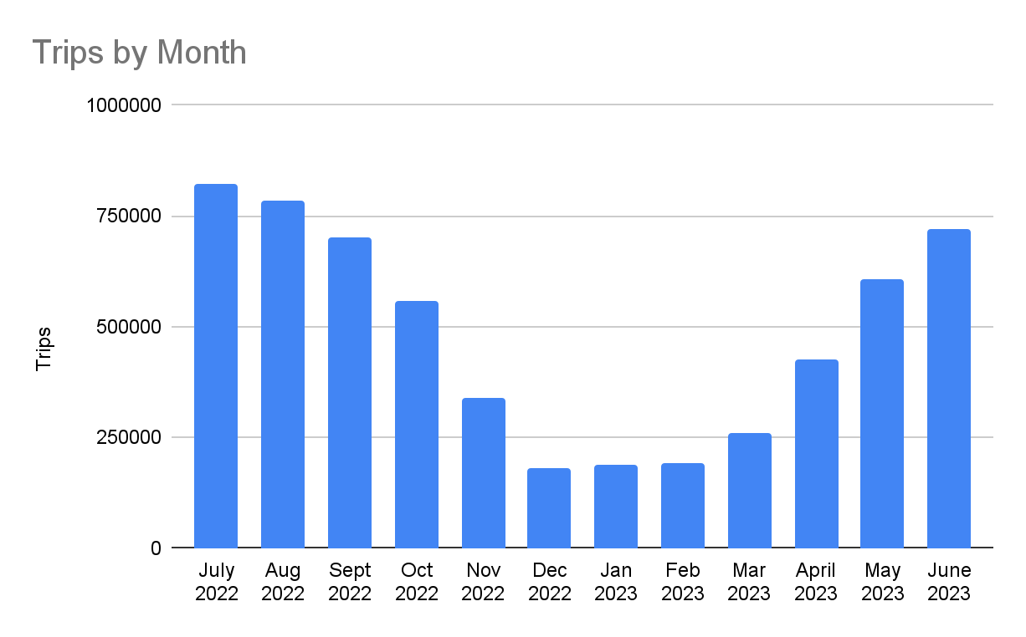
Analysis
Notes:
Unsurprisingly, ridership peaks in warmer months, and drops significantly during the Chicago winter.

Slide 6
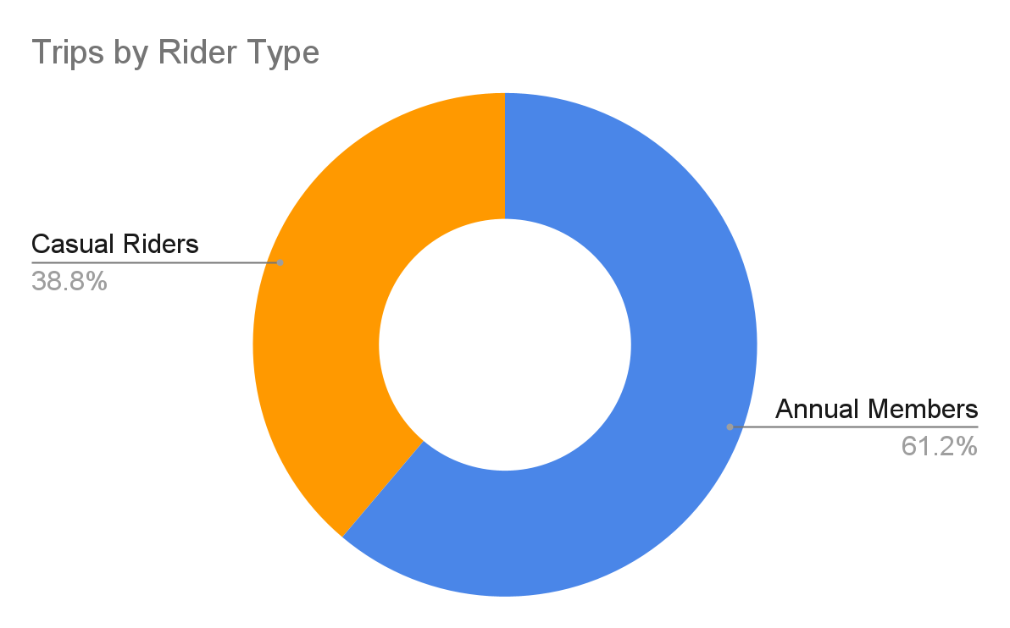
Analysis
Notes:
Majority of our trips are taken by annual members. Goal is to convert more of our casual riders into annual subscribers.

Slide 7
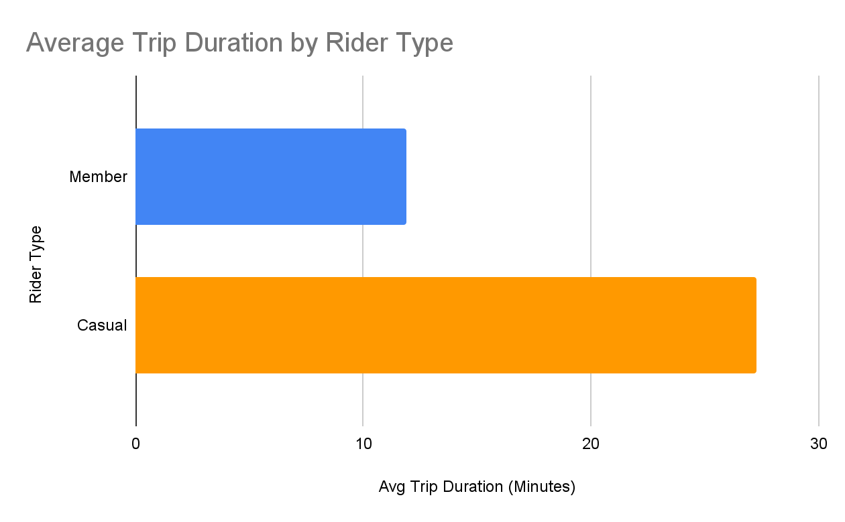
Analysis
11.9 min
27.2 min
Notes:
We can see that casual riders tend to take longer trips; more than double the average of members.

Slide 8
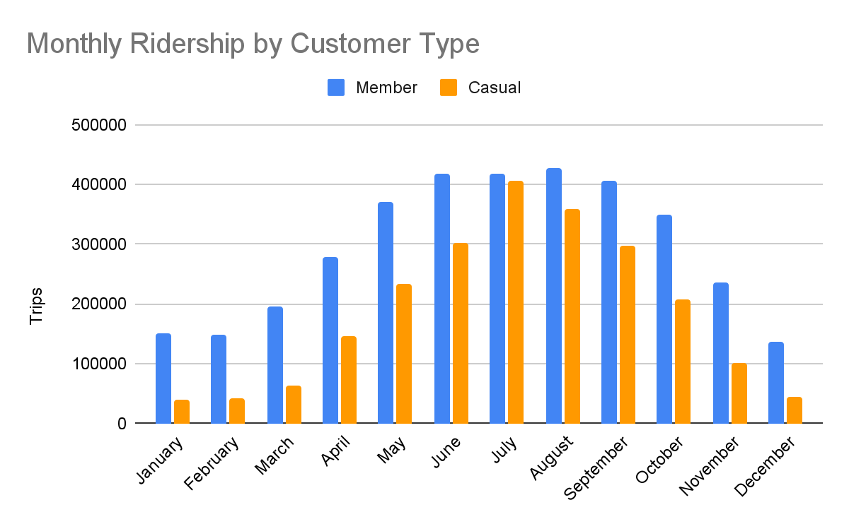
Analysis
Notes:
Both types of riders use Cyclistic more in warmer months. Trip volume by members is more consistent across the summer; while casual rider trip volume sees more of a spike that peaks in July.

Slide 9
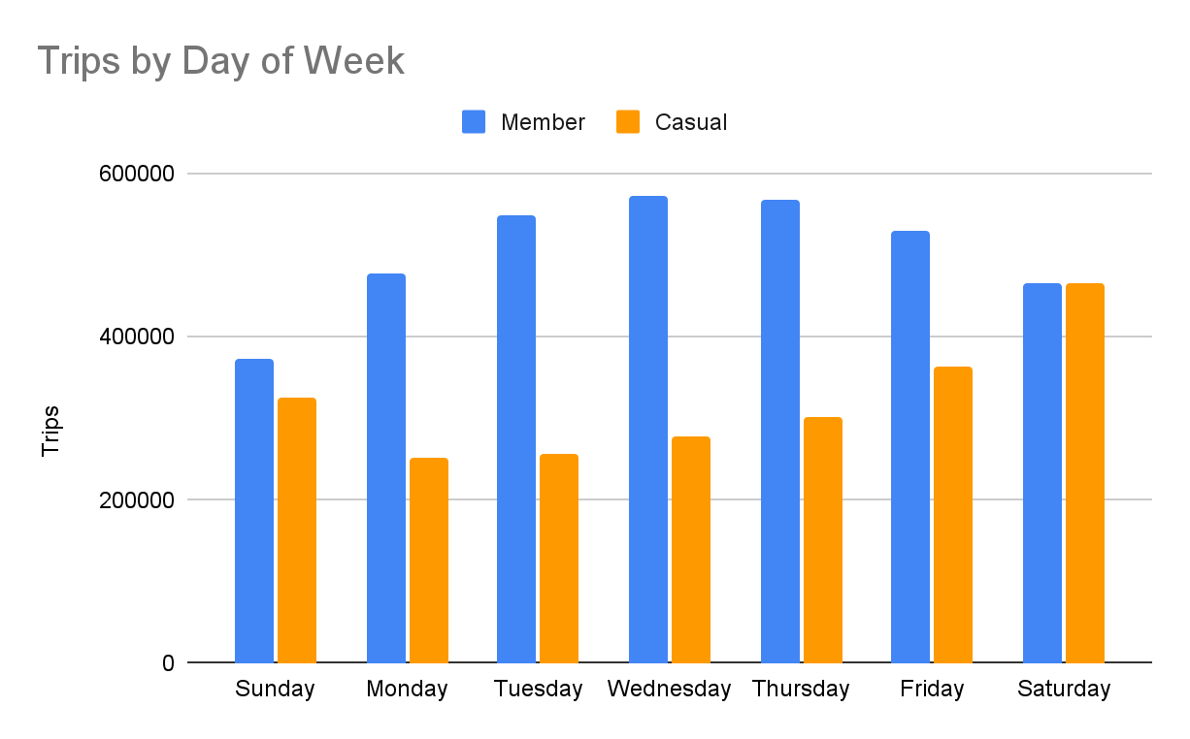
Analysis
Notes:
The data here suggests that members use Cyclistic bikes for commuting and errands during the week, while casual riders use the bikes for pleasure on weekends.

Slide 10
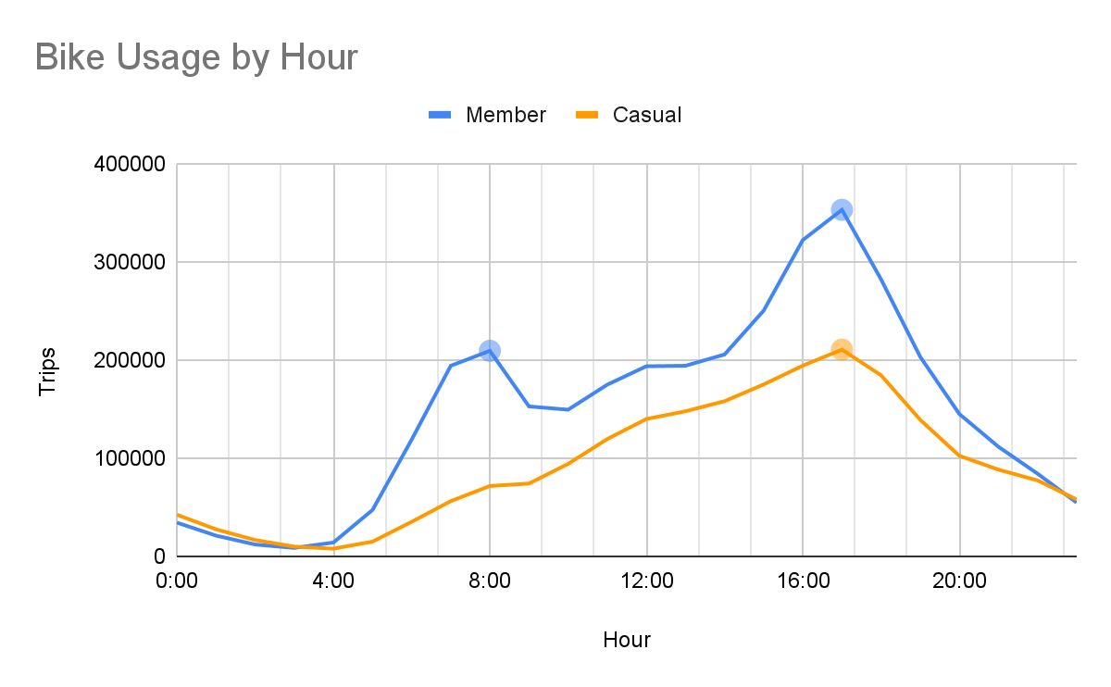
Analysis
5:00pm
8:00am
5:00pm
Notes:
We can see that members have two spikes that coincide with peak commuting times; while casual riders gradually increase usage throughout the day, peaking at 5pm and then declining into the evening.

Slide 11
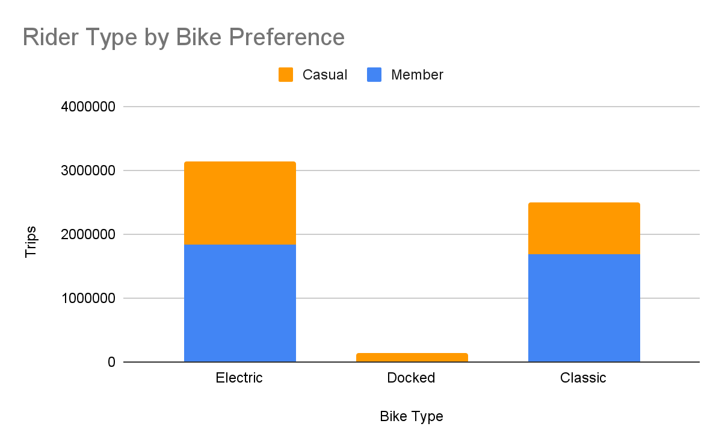
Analysis

Slide 12
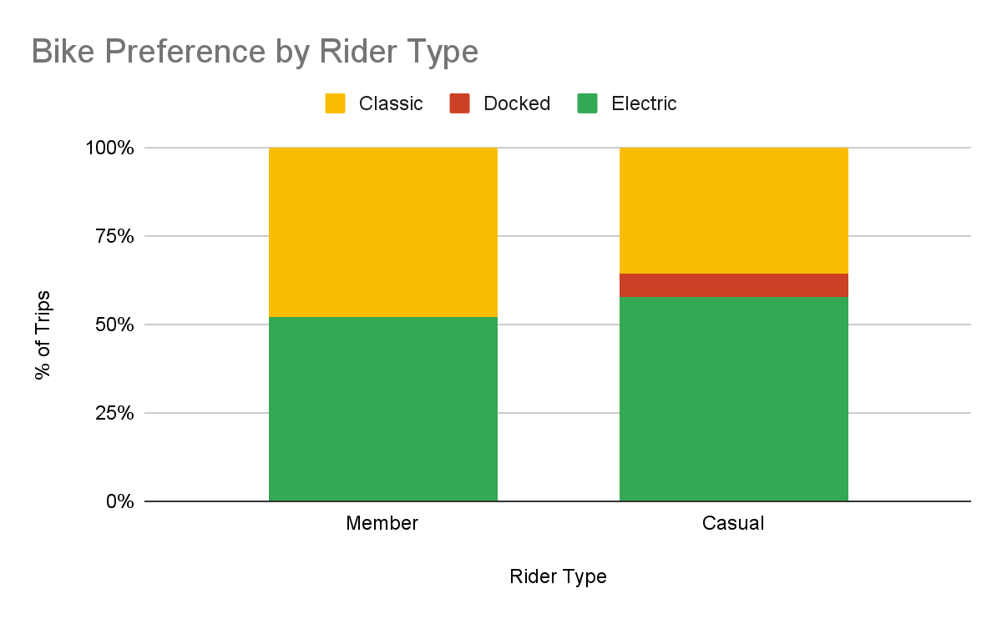
Analysis
36%
48%
6%
52%
58%
Notes:
Here we can see that casual riders tend to prefer e-bikes more than members.

Slide 13
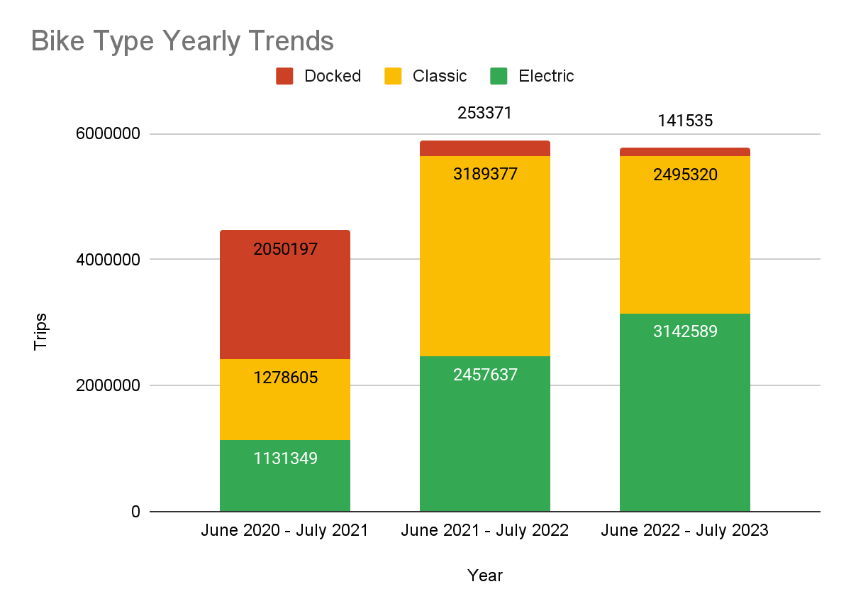
Analysis
Notes:
Looking at the past 3 years, we can see a steady rise in popularity of e-bikes. Market data suggests that this trend will continue over the next 10 years.

Slide 14
Data Limitations
Recommendations
Include member ID in future data collection to better understand member habits.
Collect name, email, or phone number as an identifier for casual riders.
No data linking trips back to specific members or casual riders

Slide 15
Questions & Challenges Answered
Challenge 1
Members
Commuting on weekdays and during rush hour
Shorter trips
More consistent usage throughout the year
Casual Riders
Longer trips
Late afternoons and weekends
Usage spike during summer months
Understand Customer Habits
How do annual members and casual riders use Cyclistic bikes differently?

Slide 16
Questions & Challenges Answered
Challenge 2
Offer bike options that are only available with memberships.
Include exclusive deals through partnerships with local businesses and attractions.
Create Value
Why would casual riders buy Cyclistic annual memberships?

Slide 17
Questions & Challenges Answered
Challenge 3
Partner with local content creators on YouTube, Instagram, and TikTok to promote using Cyclistic to get around Chicago.
Partner with sports teams and performance venues to highlight ease of travel to popular destinations in the city.
Conversion to Annual Members
How can Cyclistic use digital media to influence casual riders to become members?

Slide 18
Solution 1
Casual riders primarily use Cyclistic bikes during the warmer months.
Cyclistic could offer 3 to 6 month memberships that start in April, May, or June.
Short-term seasonal memberships

Slide 19
Solution 2
Chicago sees most of its tourism during the warmer summer months.
Cyclistic should offer multi-day passes for visitors to travel around the city during their stay.
Marketing should focus on ease of travel: not having to rely on public transportation or cost of Lyft/Uber/taxi.
Partnership opportunity: discounted entry to museums and points of interest with purchase of a multi-day pass.
Multi-day passes for visitors to Chicago

Slide 20
Solution 3
E-bikes are increasing in popularity over the past 3 years.
Introduce a higher price point for single-use e-bike rentals.
Offer a reduced e-bike rental price for members.
Offer pricing incentives for members

